Slide 1



SAMPLE
Sponsor Footfall Report
ABC Brand at XYZ Festival
May 2018

Slide 2
Introduction
XYZ festival provided a free-to-download official app. Crowd Connected’s proprietary
geo-location technology (Colocator) was embedded into the app.
Attendees who downloaded the app were asked to share their location. A positive opt-in activated the Colocator code, and these Devices were subsequently monitored for the duration of the festival, to track their movements around the festival site, including in and around the location of ABC brand’s activation(s). This sample was large enough to be representative of the total festival attendee audience.
This enables Colocator to record of how many unique Devices visited each location and for how long. From this location data, we are able to report key metrics such as the proportion of all festival attendees that were exposed to and/or interacted with a ABC brand’s activation, and for how long, providing quantitative analysis of ABC brand’s on-site presence.
This report contains a compilation of charts which combine evaluation of both engagement with ABC brand (based on footfall into the defined area of ABC brand’s activation), and exposure to the ABC brand (based on passing footfall).
This report has been prepared by Crowd Connected in accordance with the Colocator Standard Terms and Conditions and for the purpose set out in the related proposal. © 2018 Crowd Connected Ltd

Slide 3
Glossary of key reporting metrics terminology
Attendance | Aggregate number of unique Devices determined as having been in a Region over a specified time period.
Device | A piece of hardware emitting a radio frequency signal (most usually a mobile phone) for which the Colocator platform data is able to harvest a series of location fixes, thereby generating a trajectory history.
Dwell time | The time in minutes a Device spends in a Region for an individual visit. The higher the figure, the stickier the attraction.
Engagement | How many attendees went to a brand activation. The proportion of all unique trackable devices onsite that visited the activation region at least once throughout the festival timeline.
Exposure | How many attendees were exposed to a brand activation. The proportion of all unique trackable devices onsite that passed within the line of-sight of an activation at least once throughout the festival timeline.
Footfall | The number of Visits (NB not unique Devices) that commence in a given time period (e.g. 5 minutes).
Region | A defined polygonal area of any shape or size drawn on an online map using Colocator’s mapping interface. For the purposes of preparing this report Regions were drawn around the sponsor activation area(s) (whereby a Visit engagement is generated) and line of sight (i.e. passing traffic Exposure to brand)
Visits | A Visit commences when a Device enters a Region and ends when a Device exits the same Region. A unique Device may make multiple Visits.

Slide 4
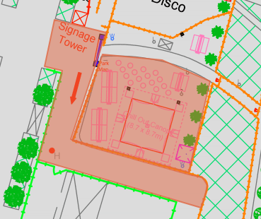
Event Details
SAMPLE
Festival Name | XYZ Festival
Dates | 25-27 May 2018
Connected Devices¹ | 22,303
ABC Brand passing traffic area (exposure, line of sight)
ABC Brand Activation area (engagement, visited)
1. The number of festival goers on site during the festival dates providing location data to Colocator platform via the official app.

Slide 5
ABC Brand Exposure Summary
Proportion of total festival attendees
exposed at least once to ABC brand
7,037
3.2
31.6%
Number of festival attendees exposed to ABC brand activation (line of sight, at least once during the festival)
Average number of brand ‘exposures’ per person
(i.e. number of times passed by activation within line of sight)

Slide 6
ABC Brand Exposure by Time
Footfall by day / hour
Peak footfall at 4.30pm Saturday
Friday
Saturday
Sunday

Slide 7
ABC Brand Exposure by Time
5m48s
681hr
x 7,037 =
Average exposure
time (per Device)
Total exposure
time (all Devices)

Slide 8
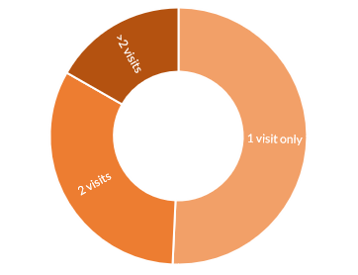
ABC Brand Engagement Summary
Average number of visits: 1.6
4,866
21.8% of total festival audience
Total visits: 7,783
Number of festival goers
that visited ABC brand
activation at least once
Repeat visits: 49.3%

Slide 9
ABC Brand Engagement by Time
Attendance by day / hour
Peak attendance at 2.30pm Saturday
Friday
Saturday
Sunday

Slide 10
ABC Brand Engagement by Time
13m48s
1119hr
x 4,866 =
Average attendance
time (per Device)
Total time
(all Devices)

Slide 11
ABC Brand Attractiveness
How well did the activation perform in converting passing footfall?
63%
# exposures | Cumulative who visit
1 | 69%
2 | 83%
3 | 91%
4 | 98%
5+ | 100%
Total brand Engagement (Devices) as a proportion of
total brand Exposure (Devices)
Exposure efficacy (how frequently festival goers passed by before visiting activation)

Slide 12
ABC Brand Popularity
How busy was the activation?
Peak time each day
5:00pm
Friday
2:30pm
Saturday
4:00pm
Sunday
Utilisation rate (as a percentage of peak time Device count)

Slide 13
Built from the ground
up for live events.
W: CROWDCONNECTED.COM
E: MAIL@CROWDCONNECTED.COM
T: +44 1483 685 970

